Slide 1

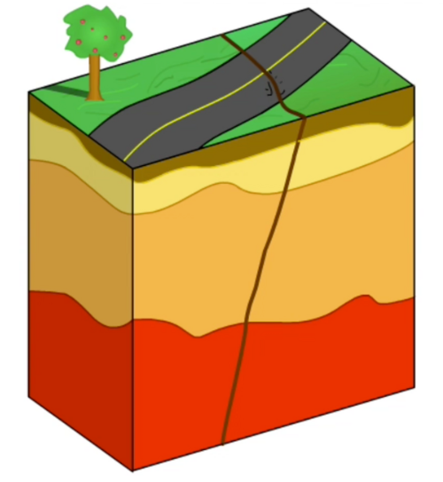

Fracture Detection From Seismic Images
Information Systems Project
Team 28
-Mohammed Fayiz Parappan
-Sneha Kumari
-Ronit Wanare

Slide 2


Table of Contents
Project Overview
System Description
Specific Requirement
Milestones/Deliverables
Language/Software/Dev-OPS tools
Code walkthrough results
Unit testing results
Improvement plan

Slide 3

Project Overview
Project Title: Fracture Detection from Seismic images
Problem Statement:
Fracture/Fault detection from seismic images is an integral task both for geoscience research and industries involved in oil extraction.
Present detection technique involve tremendous task of printing inline seismic data on large sheets and raw observation across pixel columns on the sheet.
Large number of workforce is required for faster detection.
High Human error
This results in significant cost of resources and time to identity faults. Present development in the field of deep learning and image segmentation have opened possibilities of segmenting fault layers.

Slide 4
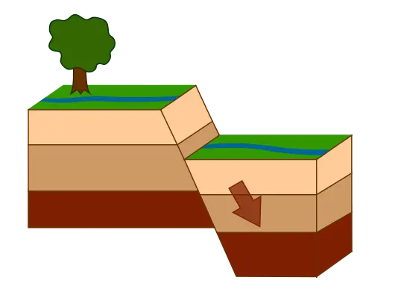

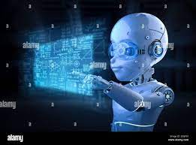
System Description
A model to detect and present fault/fracture layer using deep learning techniques

Slide 5


Pre-Mid Sem Milestones
The Following are the milestones which we achieved by the end of mid-sem:-
Performing Transfer learning on the prefitted U-net model(fault sec 3D) on synthetic seismic image dataset to extract features out of our model and to increase model accuracy.
Designing and framing custom Unet model as per user Input annotations, such as taking filter size, no.of Convolution layers and filter number as Inputs from the user.
Designing and framing GUI for Es based coherence algorithm.

Slide 6
Post-Mid Sem Milestones
The Following are the milestones which we have achieved post midesem:-
Designing of 3 UI pages for different algorithms of Fault detection and custom training model:
Train 3D net using custom Unet model
Deep Learning based 2D fault Detection
Deep Learning based 3D fault Detection
Integration of custom Unet model and 3D fault detection supporting real-time access to user to operate fault sec 3D.
Transfer Learning For Fault Detection on Real Seismic images (K-G Basin).

Slide 7
Post-Mid Sem Milestones
The Following are the milestones which we have achieved post midesem:-
Minute changes suggested by ONGC:
In the 2D result view tab, the result view could be in the right sub-plot and the seismic volume could be in the left subplot.
In the 2D result view tab, when a subplot is being zoomed, the other sub-plot is not zooming in the exact same way.
Visualization menu could be shifted to the right of import tab.

Slide 8
Post-Mid Sem Milestones
The Following are the milestones which we have achieved post midesem:-
Implemented “Save File” option to save files after fault segmentation is generated.
Denoising the Seismic data using LRTV algorithm
Integrating denoising feature in GUI to allow user to inspect denoised block of image as per provided dimensions in real time through plots.
Implementing small changes in the Train 3D Unet page1 - removal of black screen, resizing whole page.
Code Documentation

Slide 9
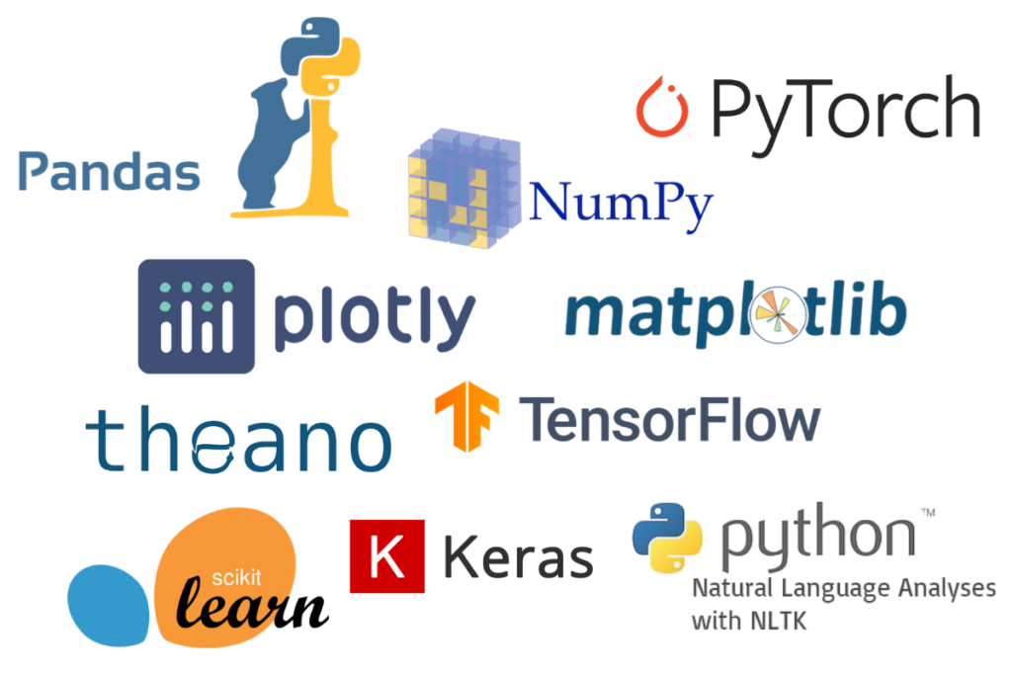
Languages/Libraries used-
-Python (via Jupyter Notebook)
-Tensorflow (for deep learning model)
-Segyio (for handling standard seismic data)
-Matplotlib (to plot results)
-Numpy
Numerous Libraries are used in the UI design code files such as tqdm, segpy, ray, sklearn, gurobipy and many more…

Slide 10



Software:-
-Qt Designer (for UI model)
-Spyder(for ide purpose to edit code)
-Notepad++(for ide purpose to edit code)
-Cuda compilation tools, release 11.2, V11.2.67
Build cuda_11.2.r11.2/compiler.29373293_0
Operating System:-
-Windows

Slide 11
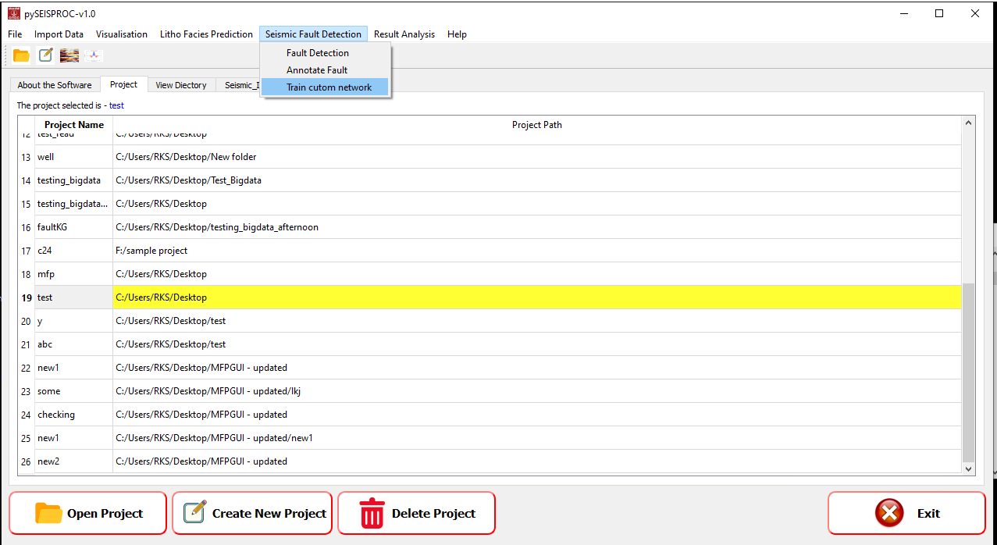
MAIN PAGE

Slide 12
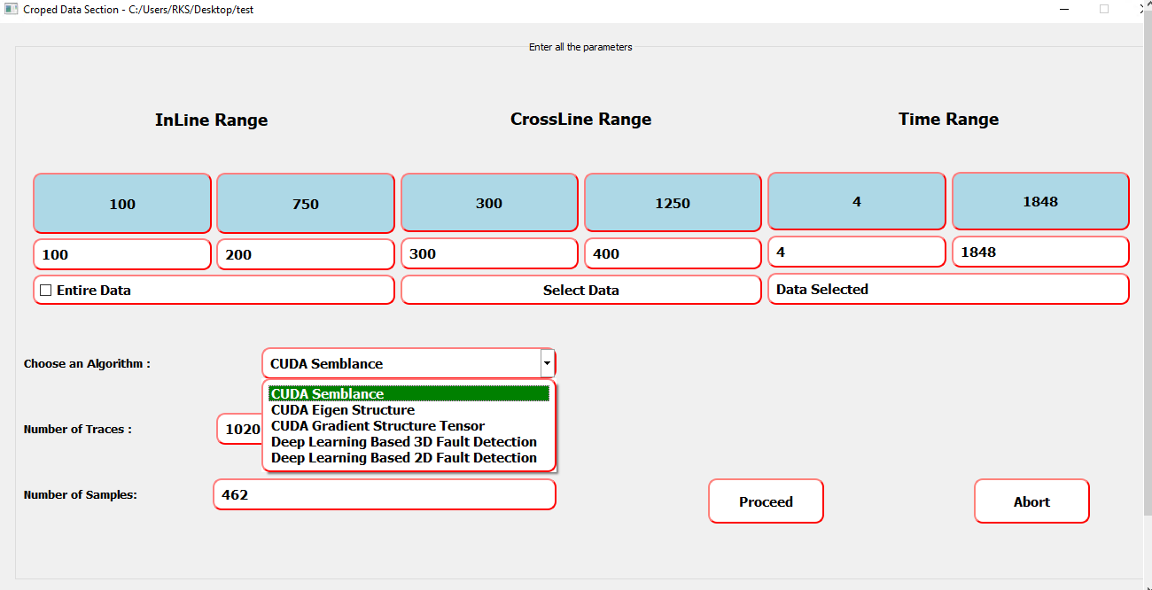
Croped_Data.UI
Page 1 -
Added new items in dropdown menu for Algorithm Selection and integrated it with the new page for Eigen Structure algorithm, Deep Learning based 2D and 3D fault detection pages.

Slide 13
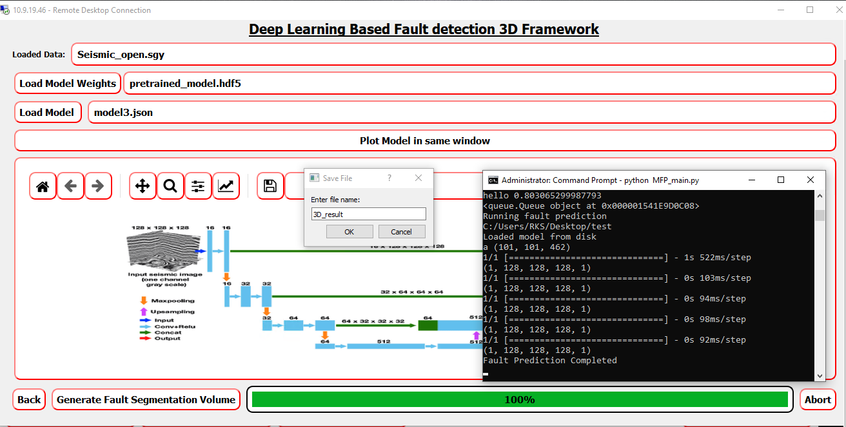
Deep Learning based 3D fault Detection

Slide 14
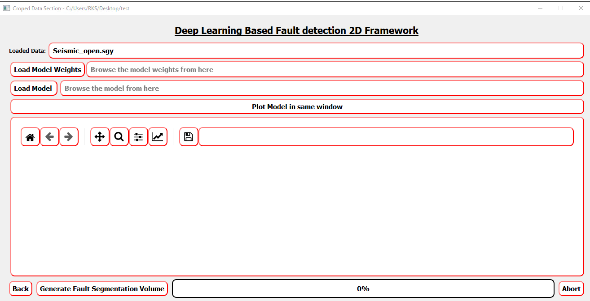
Deep Learning based 2D fault Detection
~partial integration left

Slide 15
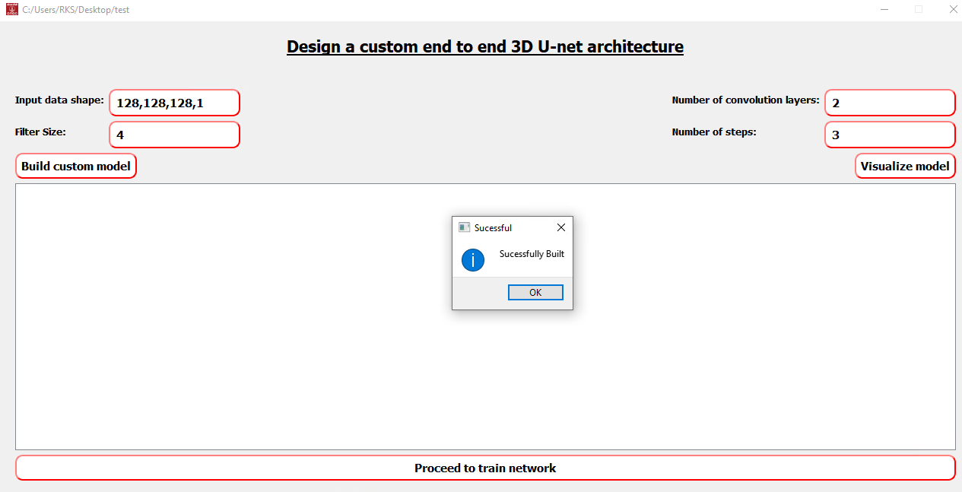
Train 3D net using custom Unet model

Slide 16
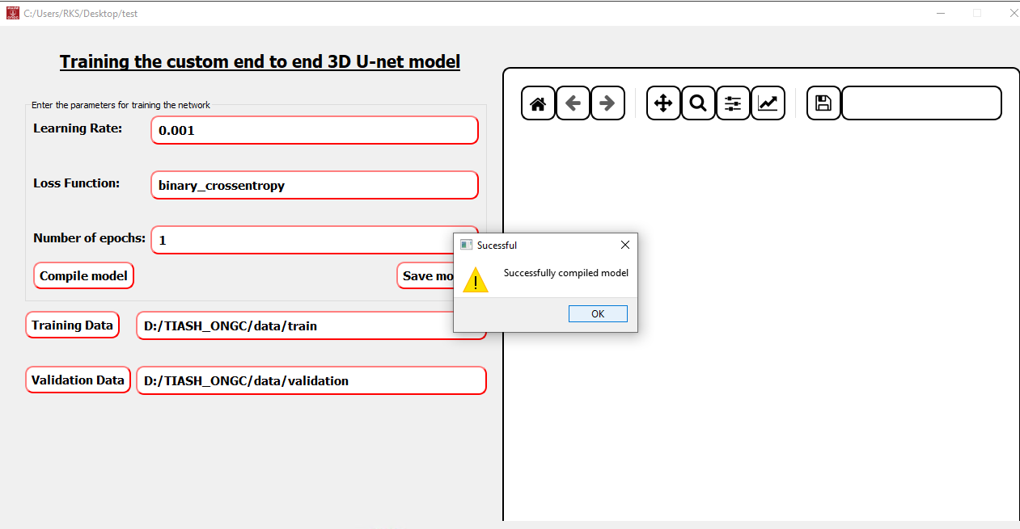
Train 3D net using custom Unet model

Slide 17
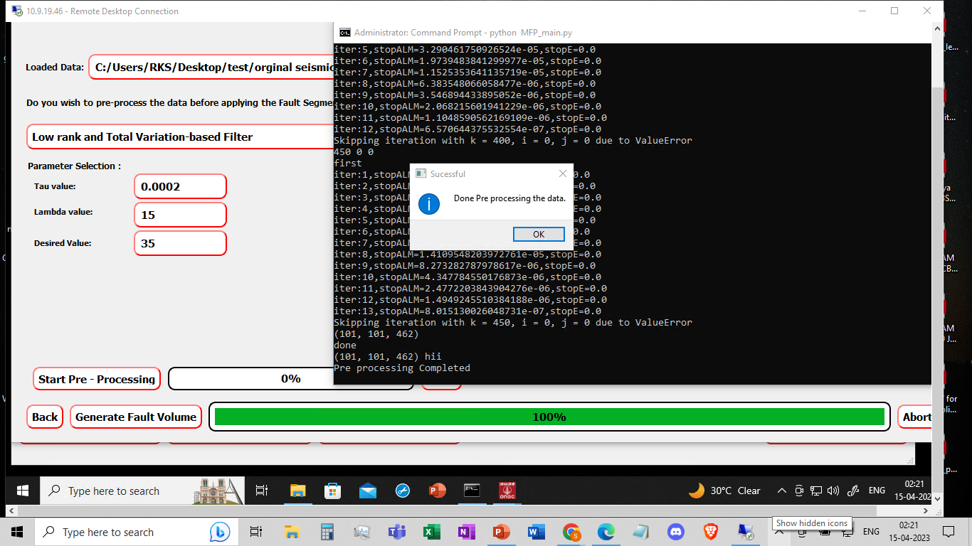
Data PreProcessing

Slide 18
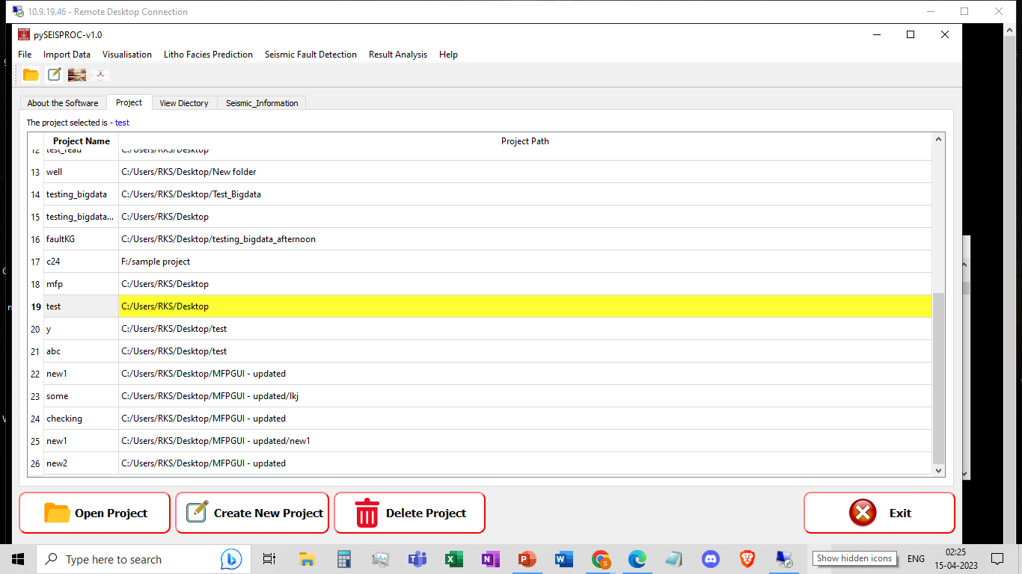
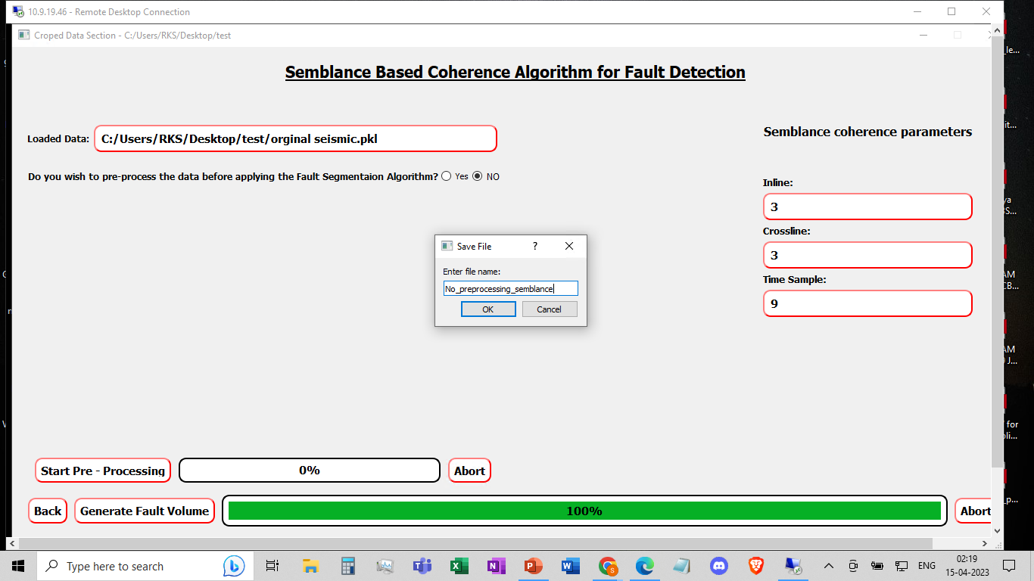
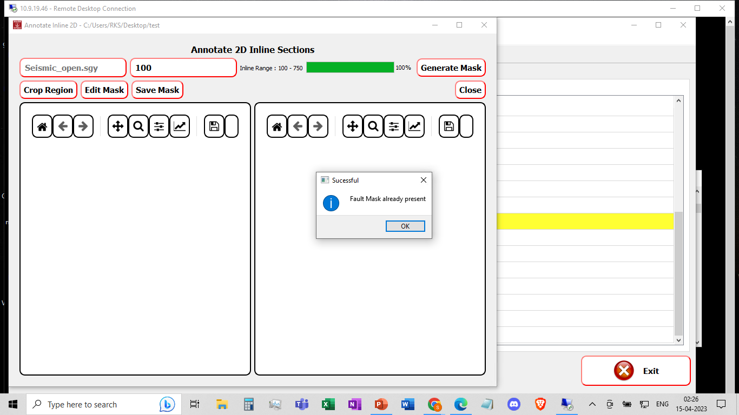
Save File, Visualization Tab, Annotate 2D Inline

Slide 19
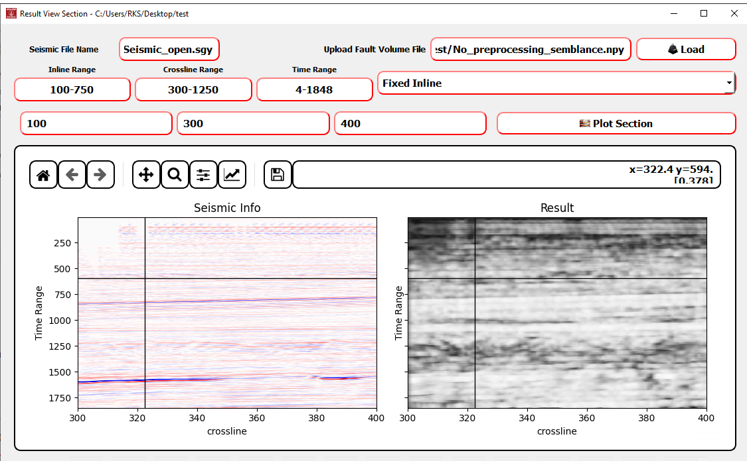
2D Viewer

Slide 20
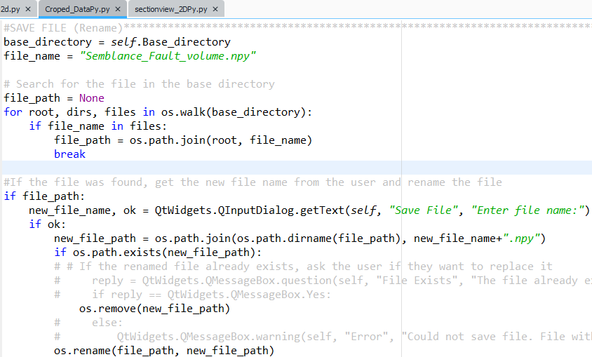
Code Snippet - Save File
CropedDataPy.py
This chunk of code is used to enable save file option at various places.

Slide 21
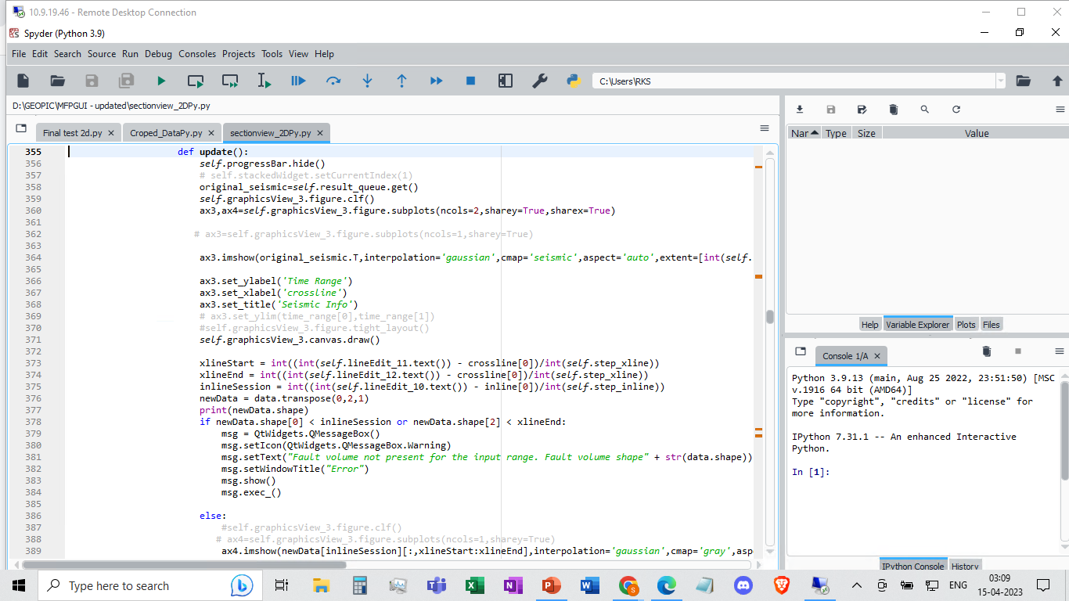
Code Snippet - 2D viewer
SectionView2DPy.py.py

Slide 22
Denoising the Seismic data using LRTV algorithm

Slide 23
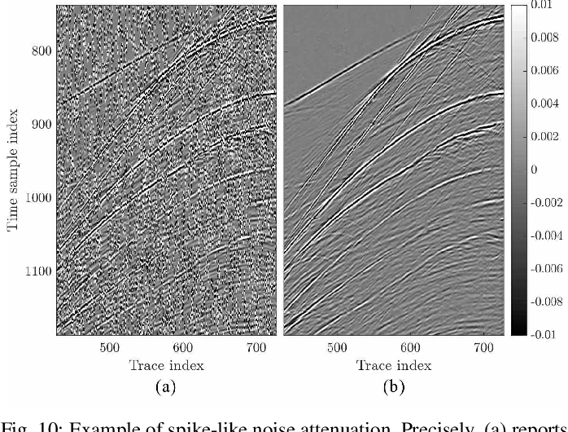
Why denoising?
Denoising is a critical step in processing seismic data in the oil and gas industry. Seismic data is acquired by generating sound waves and recording the echoes that bounce back from the subsurface layers of the earth. However, the recorded data is often contaminated with noise, which can distort the signal and make it difficult to interpret.

Slide 24
LRTV( linear regression with total variation regularization)
The LRTV (Linear Regression with Total Variation regularization) algorithm is a method for denoising 3D seismic data. It is a type of model-based denoising algorithm that uses a combination of linear regression and total variation regularization.
Local regression involves fitting a model to a small neighborhood of each point in the image, which helps to preserve local structures and patterns. Total variation regularization penalizes the total variation of the image, which helps to smooth out noise and preserve sharp edges and features.

Slide 25
How LRTV works ?
Here's how the LRTV algorithm works:
The seismic data is first divided into small patches.
For each patch, a linear regression model is fit to the data using nearby patches as predictors.
The residual between the data and the regression model is then computed.
The LRTV algorithm applies total variation regularization to the residuals to suppress noise while preserving edges and fine details.
Finally, the denoised patch is obtained by adding the regularized residuals to the regression model.

Slide 26
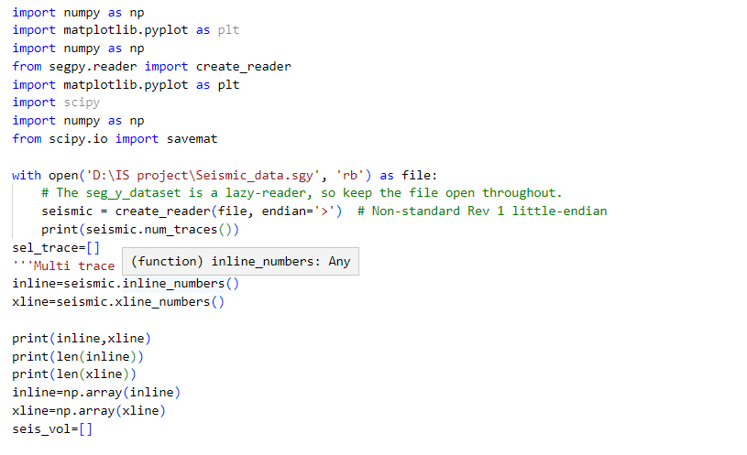
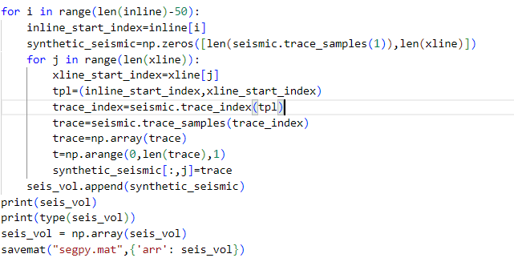
Approach for Implementing Denoisization using LRTV:-
Reading the .sgy and converting it to .mat file as we can use various libraries which makes it more flexible to use as compared to numpy.

Slide 27
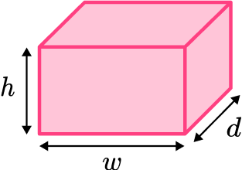
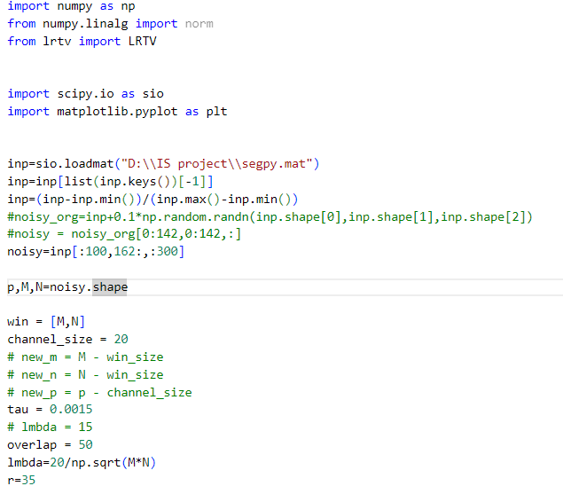
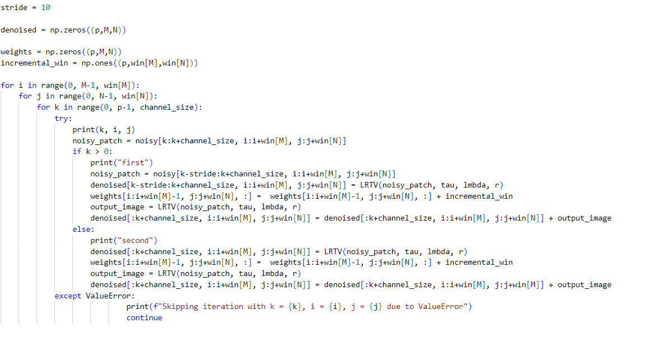
2. Reading the .mat file and move along the time axis of the data taking win_size as spatial dimensions of the data along with adjustable weights for proper denoization.

Slide 28
Custom U-NET

Slide 29
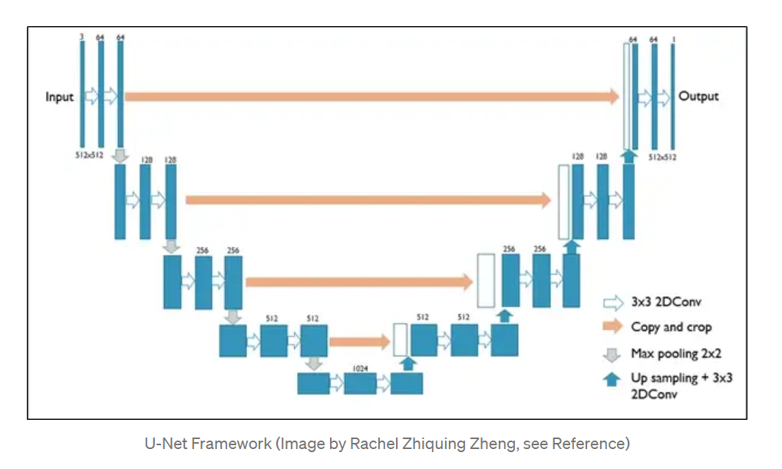
U-Net framework for image segmentation
-Originally developed for segmentation in medical images

Slide 30
Custom Model Framing as per user Annotations
The custom unet model provides the flexibility to user to optimize the model in terms of following ways:-
The user can provide number of convolution layers along with number of filters in each layer by keeping constant dimension of 2X2 for max_pooling layer.
User can according choose the downsampling rate,which gives access to optimize model performance as per user.It also gives an error if the parameters provided by the user are not computationally possible.

Slide 31
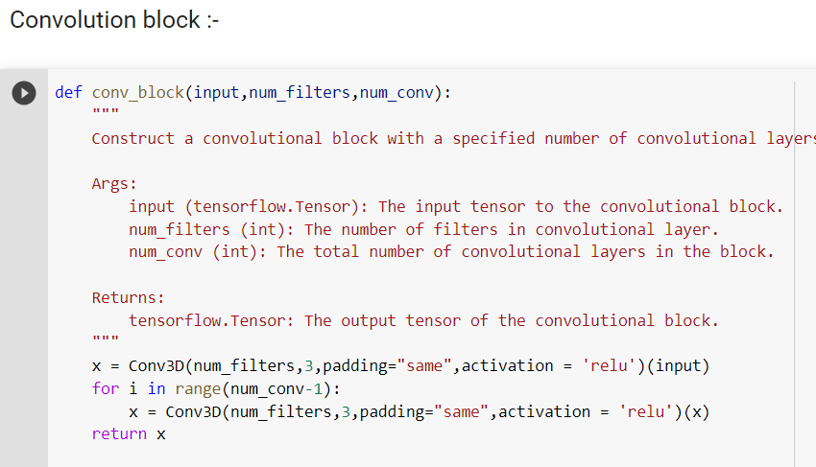
Code Main Highlights
The following are the main highlights of our Custom-Net3D which allows the flexible approach for model design:-

Slide 32
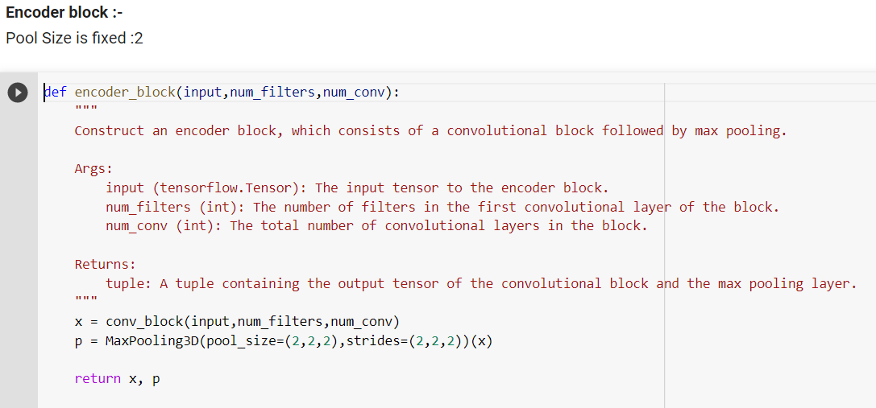
2. Encoder block

Slide 33
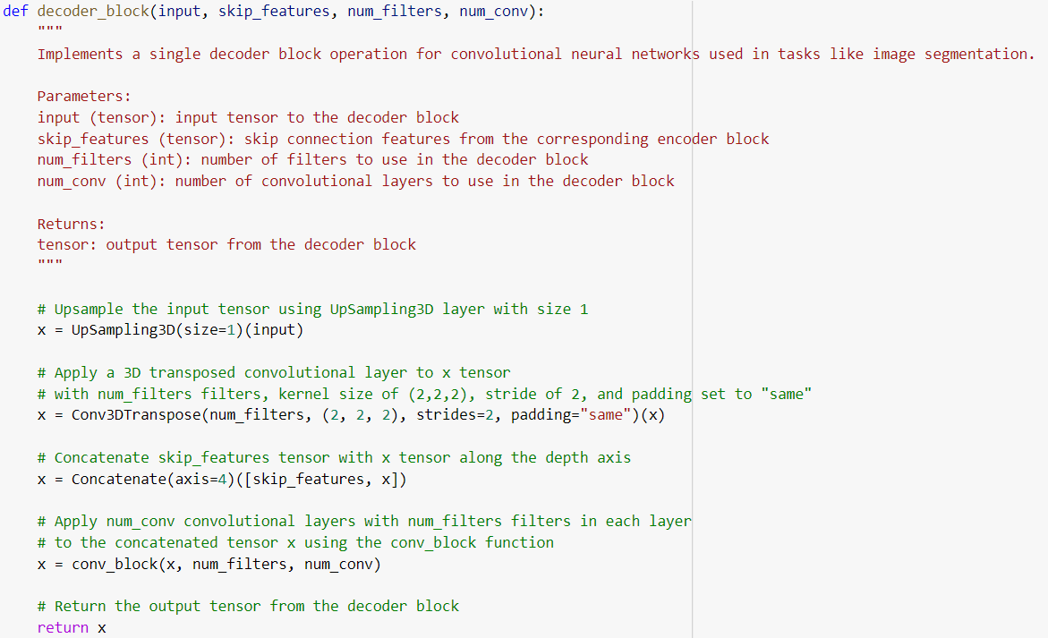
3. Decoder block :-

Slide 34
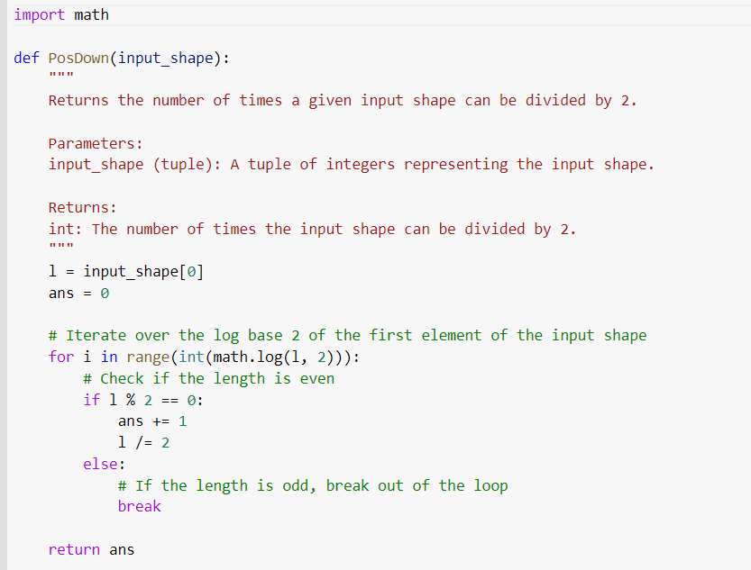
4. The Error trigger function:-

Slide 35
Transfer Learning For Real Fault Detection
Pre- midsem:- Fault Detection on synthetic fault detection

Slide 36
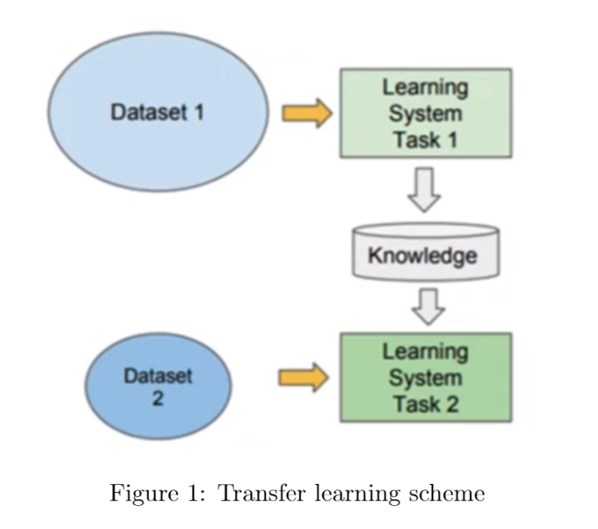
Continual Learning:- Transfer of Learnt Knowledge
Dataset 1:- Synthetic 2d seismic images
Task 1:-Fault detection from synthetic
Dataset 2:-Real Seismic images (K-G Basin)
Task2:- Real Fault Detection

Slide 37
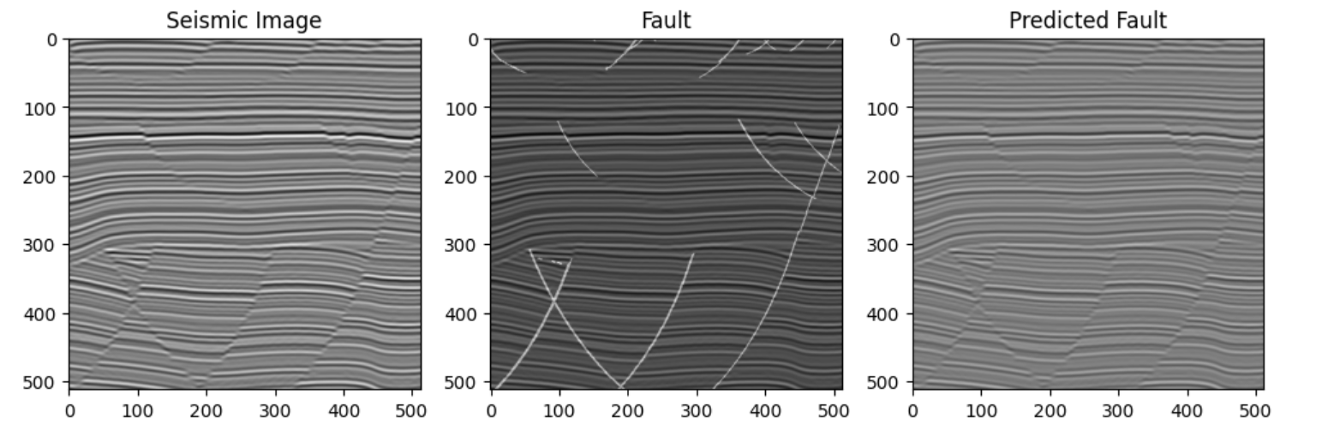
What we have?
Synthetic Model

Slide 38
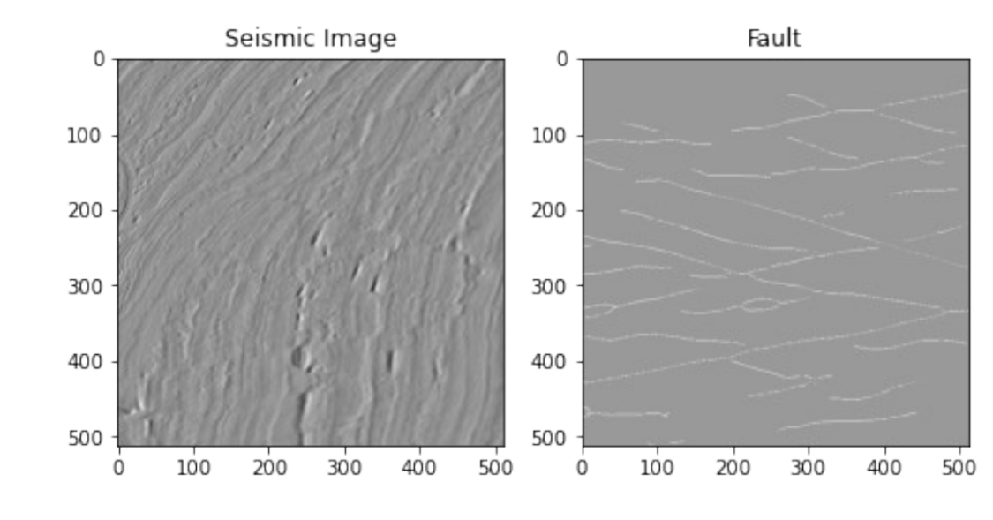
What we want?

Slide 39
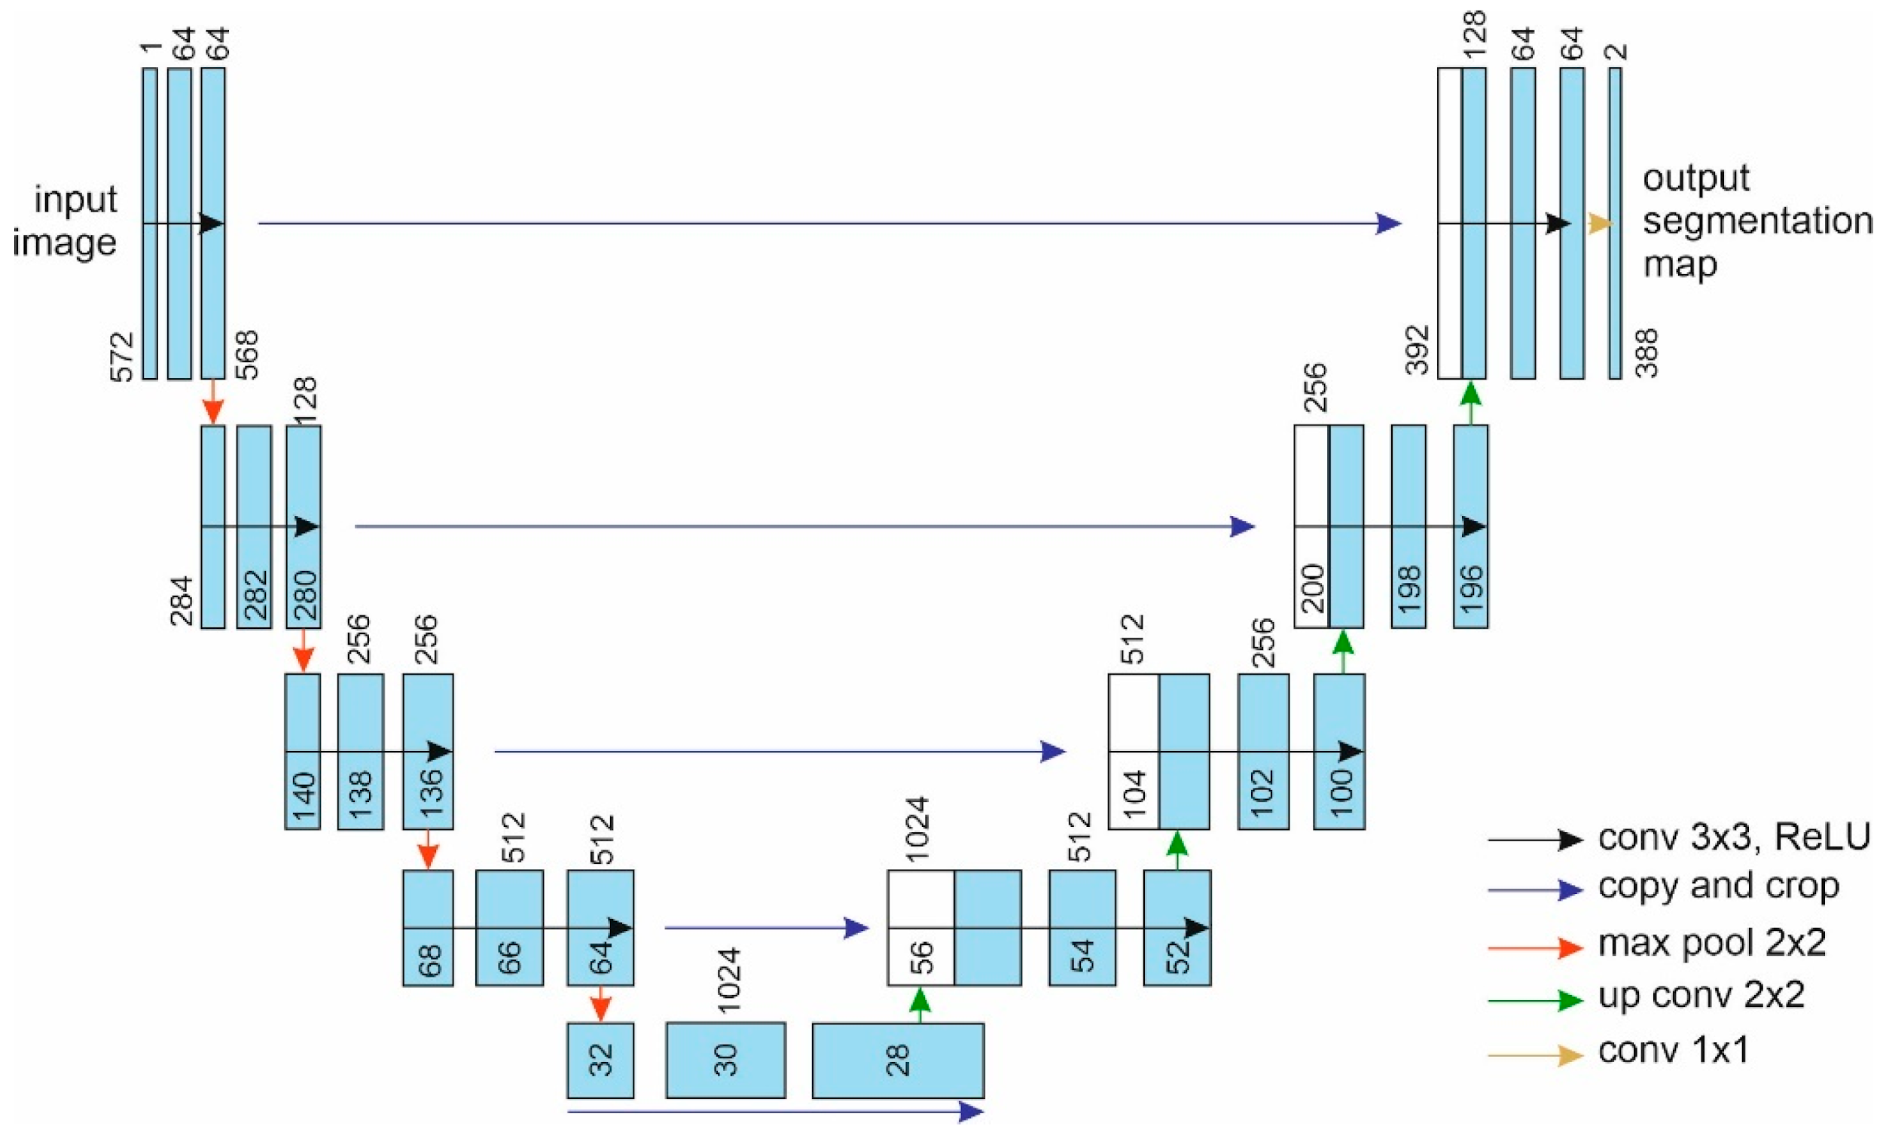
Frozen Layers

Slide 40
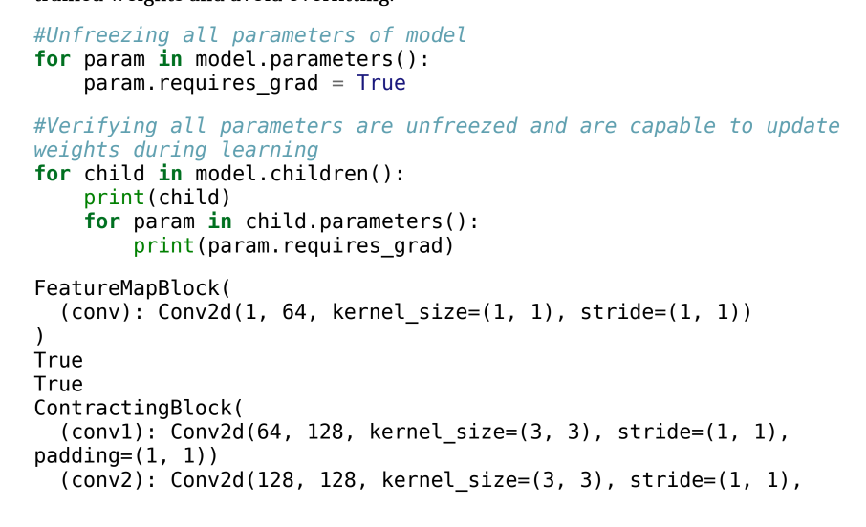
Code To Freeze and Unfreeze

Slide 41
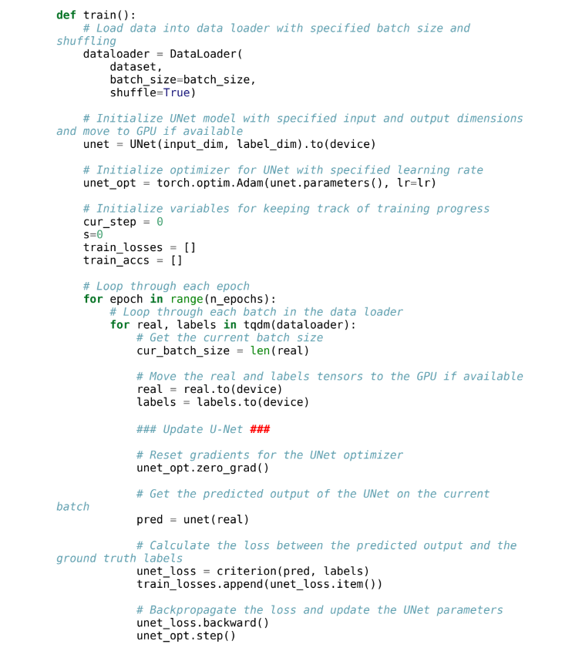
Training Model on Unfreezed Weights

Slide 42
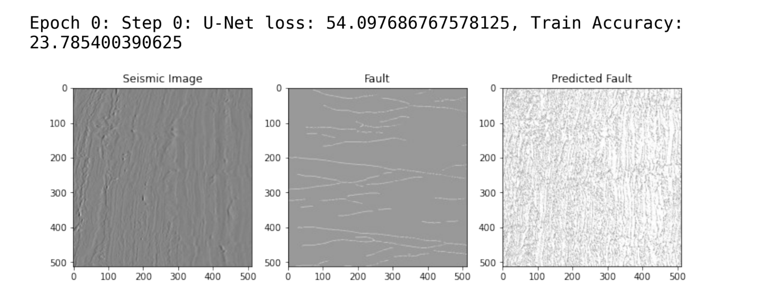
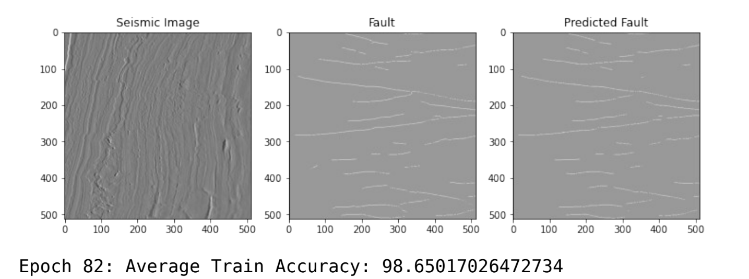
At 0th Epoch
Final Epoch

Slide 43
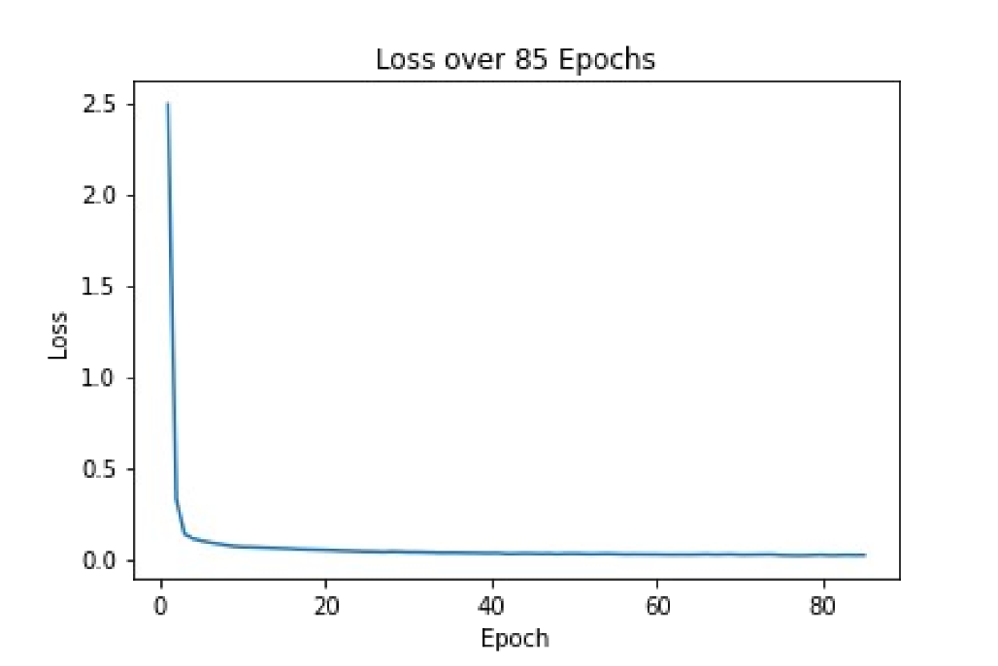
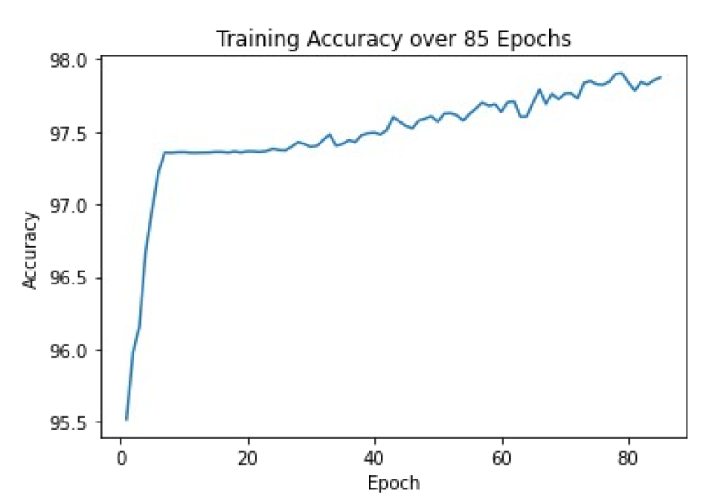
Loss Curve And Accuracy Curve

Slide 44
Deep Learning based 2D fault Detection

Slide 45

Future work:
Save options in Annotate 2D
Complete integration of the 2D Fault detection UI page
Train 3D Unet - Loss & accuracy curve printing ( training + validation)
2D network testing page - Custom 2D Unet model
Notes:
Detect fault layer from synthetic seismic image using UNET model architecture, apply transfer learning over the model by fine-tuning final layers of encoder and decoder (if possible)
Work to be accomplished before midsem: Train and develop fault detection model using UNET model architecture

Slide 46
Thank you
~ Team 28
Notes:
Detect fault layer from synthetic seismic image using UNET model architecture, apply transfer learning over the model by fine-tuning final layers of encoder and decoder (if possible)
Work to be accomplished before midsem: Train and develop fault detection model using UNET model architecture

